Slide 1
JourneyBox – Smart Travel Companion App
CSE7302- University Project
Review-3
Batch Number: CSE_164
Under the Supervision of,
Ms.Delsy Jyothi
Assistant Professor
School of Computer Science and Engineering
Presidency University
Roll Number | Student Name
20221CSE0626 | THEJAS C
20221CSE0624 | T M TEJASHWINI
20221CSE0628 | VINAY K HIREMATH
Name of the Program: CSE7302-University Project
Name of the HoD: Dr. Blessed Prince
Name of the Program Project Coordinator: Mr.Muthuraju V
Name of the School Project Coordinators: Dr. Sampath A K , Dr. Geetha A

Slide 2
Content
Problem Statement
Objectives
Literature survey
Analysis of Problem Statement
Git-hub Link
Timeline of the Project
References

Slide 3
Problem Statement Number: SIH25082
Organization: Government of Kerala
Category (Hardware / Software / Both) : Software
Problem Description:
Travelers often struggle to manage and access trip-related information such as itinerary, booking details, travel documents, expenses, and emergency contacts. This information is usually scattered across messages, emails, screenshots, and different apps, making it difficult to retrieve at the right time.
There is a need for a mobile travel application that can be installed on smartphones to capture, store, and organize trip-related data, provide real-time assistance during the trip (reminders, navigation support, offline access), and improve overall travel convenience, safety, and trip management efficiency.

Slide 4
Objectives
To develop a mobile application that can capture and store complete trip-related information (itinerary, bookings, documents, notes).
To provide organized trip management through a single dashboard for each journey.
To assist travelers with reminders and real-time trip support during travel.
To enable offline access to important trip details in low-network areas.
To help users track trip expenses and budgets for better financial planning.
To improve traveler safety by providing emergency contact and SOS support.

Slide 5
Analysis of Problem Statement
Technology Stack Components:
Mobile Application (Frontend)
Android Studio
Language: Java/Kotlin
UI: XML Layouts + Material Design Components
Backend / API
Java
REST APIs
Database
Firebase Firestore

Slide 6
Analysis of Problem Statement (contd...)
Software Requirements:
Software Requirements
Android Studio
Java / Kotlin
Git & GitHub
Postman (API testing)
Google Maps API

Slide 7
Analysis of Problem Statement (contd...)
Key Challenges
Trip details cloud implementation.
Users face difficulty retrieving tickets, hotel details, and itinerary quickly.
Lack of offline availability in low-network areas.
No centralized system for trip budget & expense tracking.
Need for travel reminders and safety assistance.

Slide 8
Github Link
The Github link provided should have public access permission.
thejas-c/JourneyBox

Slide 9
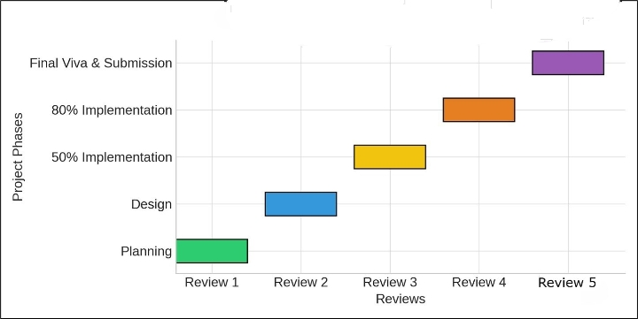
Timeline of the Project (Gantt Chart)

Slide 10
References
[1] A. Dickinson, K. Ghali, M. Cherrett, J. Speed, N. Davies, and C. Norgate, “Tourism and the Smartphone App: Capabilities, Emerging Practice and Scope in the Travel Domain, Current Issues in Tourism, vol. 17, no. 1, pp. 84101, 2014.
[2] D. A. Amaranggana and Buhalis, Smart Tourism Destinations: Improving Tourism Experience using Personalisation of Services, in Proc. International Conference on Information and Communication Technologies in Tourism, 2015.
[3] M. Tussyadiah and D. Wang, Tourists Adoption of Mobile Application: Motivation, Satisfaction and Behavioural Intention, Journal of Travel Research, vol. 55, no. 8, 2016.
[4] P. Kaur and S. Sharma, A Smart Travel Planner Application with the Mobile Computing, in Proc. International Conference on Intelligent Communication and Computational Techniques (ICCT) 2018.
[5] X. Y. Zheng, K. H. Lim, and J. Yang, Mobile Travel Applications and their effects on tourist experience: A review, Tourism Management Perspectives, vol. 35, pp.100-110, 2020.

Slide 11
References
[6] Ahmed Alsharif et al., systematics review I: Smart Tourism, Hospitality, and Destination: A Systematic Review and Future Direction Systematic Review (Scopus SLR, accepted 2024) — 2013 to Nov 2023.
[7] Google Developers, “ML Kit Text Recognition v2," Google, 2024 — on-screen OCR that can be used in mobile apps (can be helpful in extracting tickets/receipts).
[8] Y. Y. Yap, “Smart Tourism, Technologies and Tourist Satisfaction,” Journal/ScienceDirect, 2025 — the literature on tourist satisfaction and smart tourism technologies.
[9] (Offline-first mobile architecture direction) “Local caching and sync patterns in Android Offline-First Architectures Implementation” / engineering papers and preprints (2024-25) - advice on the patterns of local caching and syncing of mobile applications.
[10] IJNRD / IJSRET / IJPREMS published studies (2024-2025) on expense-tracker mobile applications and implementations practical implementations and UX results on the expense tracking in mobile settings .

Slide 12


